Slide 1
Quantitative Data Analysis of car data in market to draw inferences from attributes and predict user choices
Group #10

Slide 2
Table of Contents
01
02
03
04
INTRODUCTION
DATA COLLECTION AND ANALYSIS
About the project which we are doing.
What we are planning to do in the analysis of our data.
ONGOING WORK
CONCLUSION
What else are we planning to add more.
A short summary!

Slide 3

01
Introduction

Slide 4
Huge Industry
Where do you start?

Slide 5
How are we going to do?
Past
Present
Future
Existing data
Analysis
Determine the demand

Slide 6
02
Data collection and Analysis

Slide 7
Data Collection and Analysis
Data collection
Data cleaning
Analysis

Slide 8
Analysis
3º
1º
2º
Sampling
Hypothesis testing
Regression
4º
Correlation

Slide 9
HYPOTHESIS TESTING

Slide 10
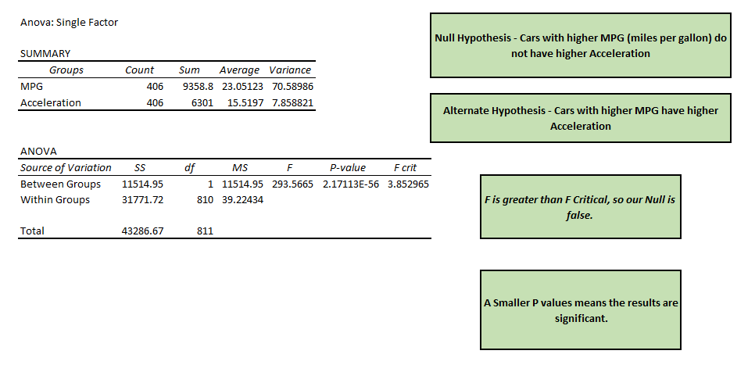
Whether cars with higher MPG have higher Acceleration or not?

Slide 11
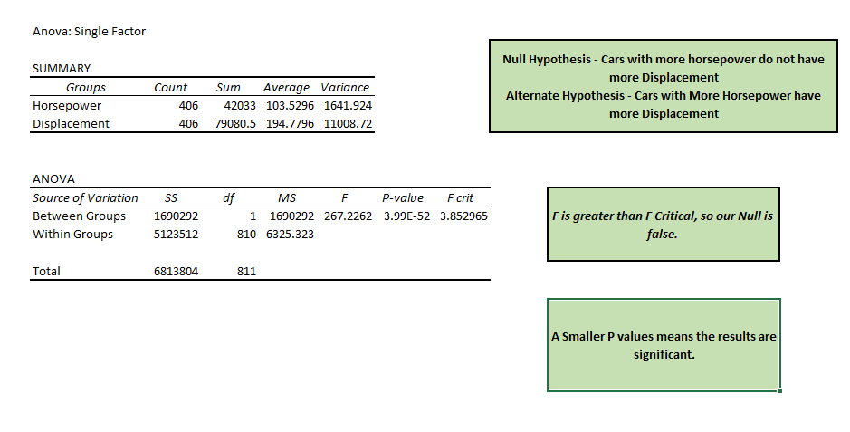
Whether cars with higher HP have more displacement or not?

Slide 12
SAMPLING

Slide 13
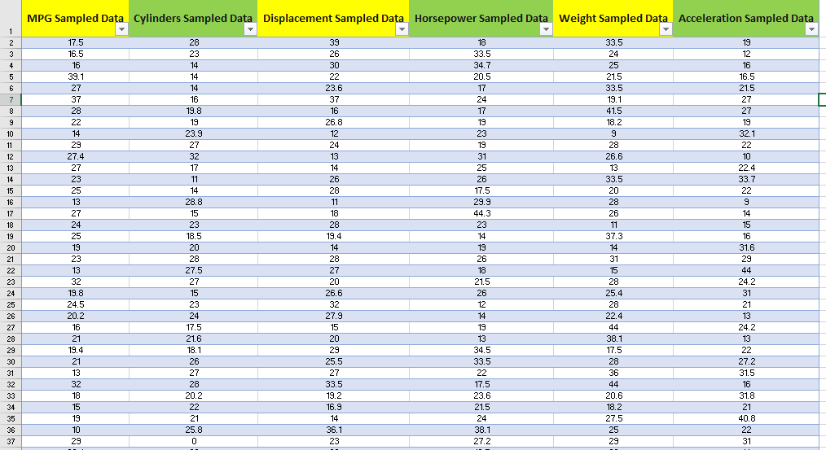

Slide 14
Random sampling based on 407 rows to 50 values.
ANALYSIS BASED ON SAMPLING
Lot of deviation from the standard figures like averages and variance
Though Random sampling is most precise but still it is not much close to true values from original dataset
Different Residual plots were plotted based on Sample Data

Slide 15
REGRESSION

Slide 16
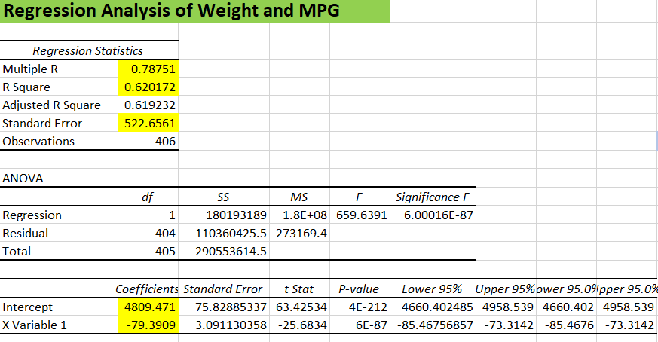
5.22357

Slide 17
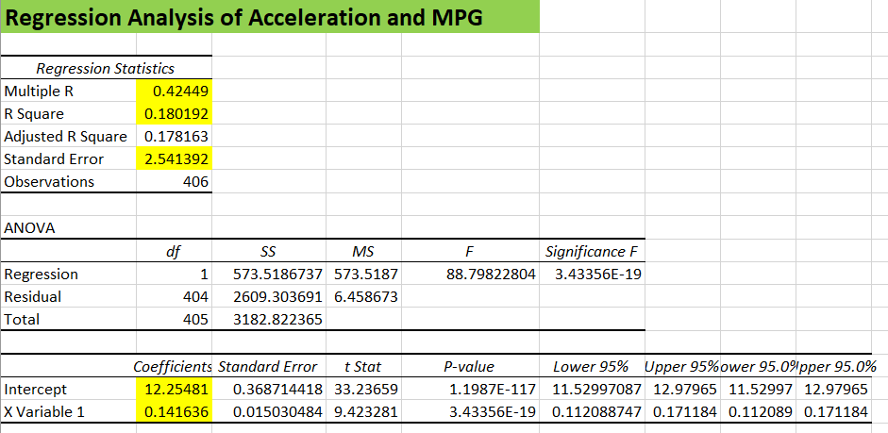

Slide 18
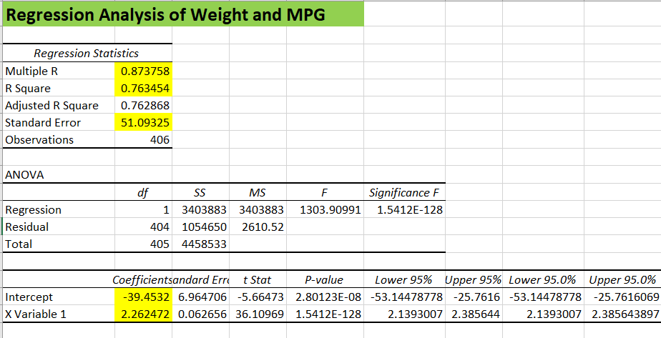
Regression analysis of Horsepower and Displacement
STRONG POSITIVE CORRELATION
3.22357

Slide 19
ASSUMPTIONS
Linearity
Independence of Errors and Equal Variance
Normality of Errors

Slide 20
CORRELATION

Slide 21
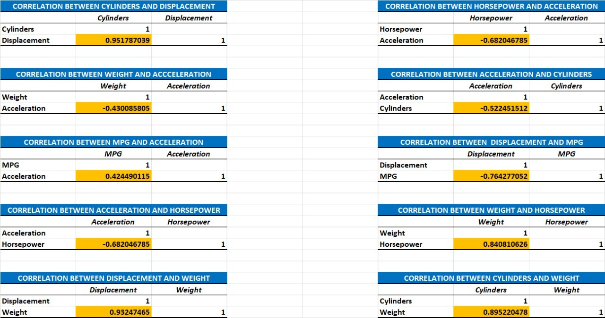
Weather cars with higher MPG have higher Acceleration or not?

Slide 22
Analysis from Correlation
STRONG POSITIVE CORRELATION:
Cylinders and Displacement 0.951
Displacement and Weight 0.932
Cylinders and Weight 0.895
Horsepower and Weight 0.840
NEGATIVE CORRELATION:
Displacement and MPG -0.764
Acceleration and Horsepower -0.682

Slide 23
03
Ongoing work

Slide 24
Ongoing work
1
More Data
2
Expanding horizon
3
Prediction Analysis

Slide 25
04
CONCLUSION

Slide 26
Hypothesis Testing
Regression
Sampling
Correlation

Slide 27
Our Team
GARIMA SHARMA
MADHAV
SHARMA
AKASH R
SHREYANS
JAIN
VIDHI KOCHAR
MBA/06/131
MBA/06/140
MBA/06/154
MBA/06/163
MBA/06/171

Slide 28
THANK YOU
Please keep this slide for attribution.

